Slide 1
SOA Resources on the Net

Slide 2
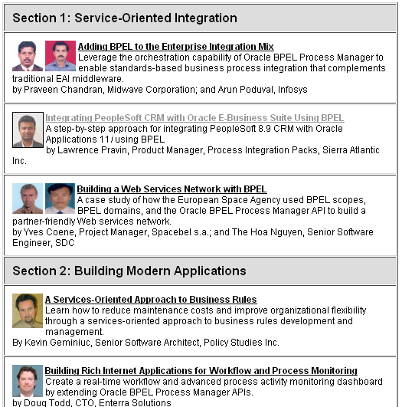
BPEL Cookbook
In this cookbook, 10 SOA practitioners share their SOA best practices and provide practical viewpoint to tackle many of the common problems SOA promises to solve. It's organized into three sections: "Service Oriented Integration," "Building Modern Applications," and "SOA Techniques." Sections 1 and 2 will "inspire" you to take the plunge into the world of services and test-drive SOA yourself; Section 3 will "equip" you with best-practice techniques for building a better SOA application.

Slide 3
General SOA Material
Architect Center is a good place to look for best practice and ideas.
SOA Resource Kit
Mastering SOA Series
SOA Suite Best Practices Guide (slightly dated)

Slide 4
Samples
Oracle by Example Home Page has lots of samples.

Slide 5
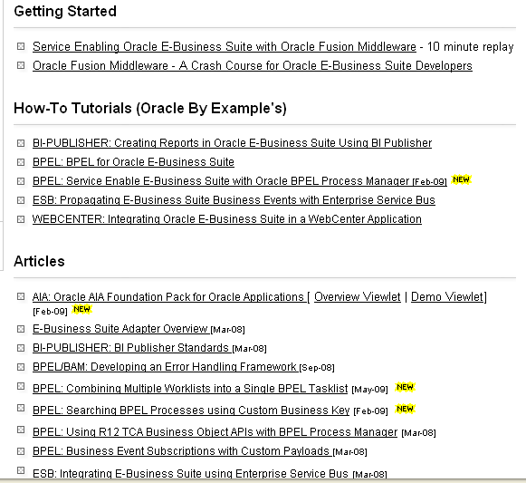
SOA For E-Biz Developers
EBiz Best Practice Center: Come here to start leveraging SOA with your Oracle E-Business Suite applications today. Learn how to service-enable Oracle E-Business Suite via Open Interface Tables, Concurrent Programs, PL/SLQ APIs, and Business Events, using the Oracle E-Business Suite Adapter, and then build integrations, business processes and composite applications using Oracle Fusion Middleware.
Check out http://www.oracle.com/technology/tech/fmw4apps/ebs/index.html

Slide 6
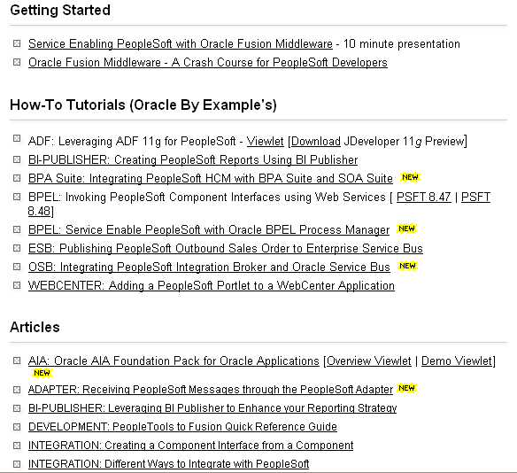
SOA For PeopleSoft Developers
Check out http://www.oracle.com/technology/tech/fmw4apps/peoplesoft/index.html

Slide 7
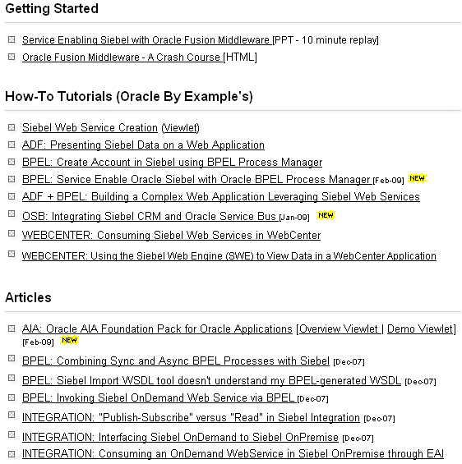
SOA For Siebel Developers
Siebel Best Practice Center: Come here to start creating SOA (Service-Oriented Architecture) with your Siebel applications today. Learn how to service-enable Siebel CRM Business Services, Workflows, and Business Components and then build integrations, business processes and composite applications using Oracle Fusion Middleware.
http://www.oracle.com/technology/tech/fmw4apps/siebel/index.html

Slide 8
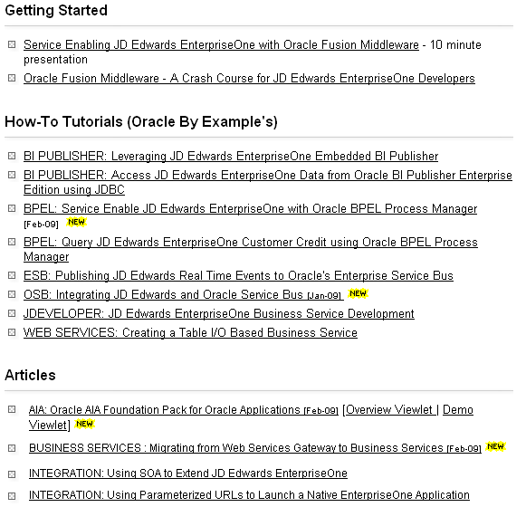
SOA For JD Edwards EnterpriseOne Developers
JD Edwards EnterpriseOne applications Best Practice Center: Come here to start creating SOA (Service-Oriented Architecture) with your JD Edwards EnterpriseOne applications today. "Best Practices" are offered for how to service-enable JD Edwards EnterpriseOne Business Services, and then build integrations, business processes and composite applications using Fusion Middleware technology such as BPEL, ESB, BAM, ADF, and WebCenter. Experts from JDE Development, Consulting, Product Management as well as leading System Integrators and customers, will show you how.
http://www.oracle.com/technology/tech/fmw4apps/jde/index.html

Slide 9
BPEL Material
BPEL Main Page on OTN (includes tutorials and examples)
BPEL Cookbook
BPEL Tech Page (Tutorials, Tech Notes, Training PDFs)

Slide 10
Rules Material
Main OTN Rules Page (includes examples) _x000b_

Slide 11
Security material
Identity Management Home Page

Slide 12
Repository Material
SOA Governance Center
Oracle Enterprise Repository and Oracle Service Registry
SOA Governance Resource Kit (requires registration)

Slide 13
Supported Configurations
Links to supported configurations

Slide 14
Books (Links to Amazon)
Oracle SOA Suite Developer's Guide
The Definitive Guide to SOA: Oracle Service Bus
BPEL Cookbook: Best Practices for SOA-based integration and composite applications development:
Business Process Execution Language for Web Services BPEL and BPEL4WS
Oracle Web Services Manager: Securing your Web Services
Oracle Identity Management: Governance, Risk, and Compliance Architecture
Oracle Enterprise Manager 10g Grid Control Implementation Guide

